Slide 1
RETAIN Community of Practice
April 2, 2020
Notes:
The moderator is an information manager. In an online environment, s/he monitors the communication flow, makes summaries and digests, approves participants’ requests and posts, and even maintains the online environment. The moderator is often quite invisible for those who participate in meetings, events and communities.
The facilitator of is much more visible and active. S/he steers the communication flow and keeps it on track. In this way, facilitation focuses on including all participants in the discussion, even the ones who are less comfortable with speaking and contributing, ensuring all voices are heard and discussion is vibrant, interesting and useful to those who participate. Having good people skills, the facilitator enables a comfortable and inclusive environment of openness and trust for those who participate.

Slide 2
Case Management TIPS for Return-to-Work (RTW) Coordinators
Leslie Dawson, MA, CRC, NCC
April 2, 2020
This document was prepared for the U.S. Department of Labor (DOL) Office of Disability Employment Policy and Retaining Employment and Talent After Injury/Illness Network (RETAIN) state grantees, by the American Institutes for Research under DOL Contract Number 1605DC-18-F-00429. The views expressed are those of the authors and should not be attributed to DOL, nor does mention of trade names, commercial products, or organizations imply endorsement of same by the U.S. Government.

Slide 3

Webinar Quick Tips
If you are having any trouble with Adobe Connect, email RETAINTA@air.org or use the chat box.
Submit questions at any time during the webinar in the chat box—or use the “Raise Your Hand” function in the top menu.
Notes:
Please mute your line when not speaking by pressing the far left green button that you see in the picture on the screen. If you need to step away from the call for any reason, DO NOT put your line on hold. Doing so may feed music into the entire conference.
We recommend that you connect via audio by having the Adobe Connect system call you. If you did not do that before, you can do that by clicking on the phone button at the top of the screen and selecting “Connect My Audio” and choosing the option for the system to call you.
If you have a question, you can type it in the chat box or press the raise hand button, which is the white icon on the top right that you see on the screen.

Slide 4
Welcome and Introductions
Please state:
  Your name
  Your state
  Your role
Share a key area of interest regarding Return-to-Work/Stay-at-Work (RTW/SAW) Case Management processes, strategies, or tools.
Notes:
-Moderator – self introduction, I’m _____ and excited to Welcome Everyone to RETAIN TA’s first session in the Community of Practice (CoP) –
Ask everyone to introduce self (Name and State).
(Needs Sensing Question) Ask Participants to type their response to “what is the most in the ___________________________________ in the QUESTION box .

Slide 5

Norms for Interaction
Be present.
Share the air.
Assume goodwill.
Respect what is shared.
Embrace productive disequilibrium.
Foster a learning culture.
Photo from Unsplash.com
“Coming together is a beginning. Keeping together is progress.
Working together is success.”
—Edward Everett Hale

Slide 6
Case Management TIPS for RTW Coordinators
Tools, Insights, Processes, and Strategies

Slide 7
Today’s Agenda
RTW Case Studies
Tools, Insights, Processes, and Strategies
State Sharing: Implementation Questions
Resource Sharing
Key Takeaways and Next Steps

Slide 8

Today’s Presenter
Leslie Dawson, MA, CRC, NCC, State Administrator, Vocational Rehabilitation Division, Alabama Department of
Rehabilitation Services
Notes:
Bio Leslie Dawson is the State Administrator of the Alabama Department of Rehabilitation Service’s Vocational Rehabilitation Business Relations Program - READI-Net (Resources for Employment and Disability Information). Leslie is responsible for developing and maintaining partnerships with business and industry within Alabama, as well as nationally, in order to assist companies with their disability and inclusion needs; including the recruitment, employment, retention and advancement of individuals with disabilities. Leslie travels state-wide providing disability and employment related trainings to employer partners on such topics as Disability Etiquette, Disability Awareness, ADAAA, Return to Work/Stay at Work initiatives, Reasonable Accommodations, Section 503 of the Rehabilitation Act, and Emergency Preparedness for Employees and Customers with Disabilities. She has over 20 years’ experience working with businesses to retain workers with injuries, illnesses and disabilities in the workplace. Mrs. Dawson received her master’s degree in Vocational Rehabilitation Counseling from the University of Alabama and is a Certified Rehabilitation Counselor, as well as a Nationally Certified Counselor.

Slide 9

Tools
Image source: Jing.fm
Notes:
When the RETAIN grants first began, each state received Tools from the Department of Labor. You guys were given documents such as:
Operational Planning and Implementation Guidance Checklist
Functional and Non-functional Requirements for State RETAIN Data Systems
Definitions and Guidelines, RETAIN Data Collection for Grant Performance Management, and Evaluation
You were also given access to Technical Assistance and Subject Matter Experts to get your grant programs up and running. Without the proper tools, implementing and operating a RETAIN grant would be extremely difficult.
The same goes for actually managing a Return to Work/Stay at Work case.
…
In this part of the training, I would like to challenge you to consider additional tools that can be used to help guide you as you manage RTW/SAW cases….
Next Slide

Slide 10
Poll: What tools and resources are you currently using to help you manage an RTW/SAW case?
Notes:
Question: What tools are you currently using to help you manage a RTW/SAW case?
Possible Answers: Professionals – RTW Coordinator, Healthcare Professional, Employer, Workforce Partners; Data Elements; Electronic Record Keeping system; What else? Take a deeper dive…
In this part of the training, I would like to challenge you to consider additional tools that can be used to help guide you as you manage RTW/SAW cases….
Next Slide

Slide 11

Tools
Questions to ask employee
Questions to ask employer
Indicators of problems on the job
Helpful documents

Slide 12
Questions to Ask Employee
Employee awareness of the situation
Employer awareness of the situation
Employee desire to RTW/SAW
Attitudinal barriers present
Notes:
One of the most important Tools to use in a RTW/SAW cases is the intake questionnaire. By intake questionnaire, I don’t mean name, address, date of birth, etc. What I mean by intake questions is – what are the questions you need to ask to truly get at the true story, the real circumstances around an injured employee’s RTW/SAW situation. By asking certain questions of the employee, you will be able to gain a deeper understanding of the challenges and opportunities for the employee. Let’s take a look at some of these very important questions and discuss why these questions should be asked.

Slide 13
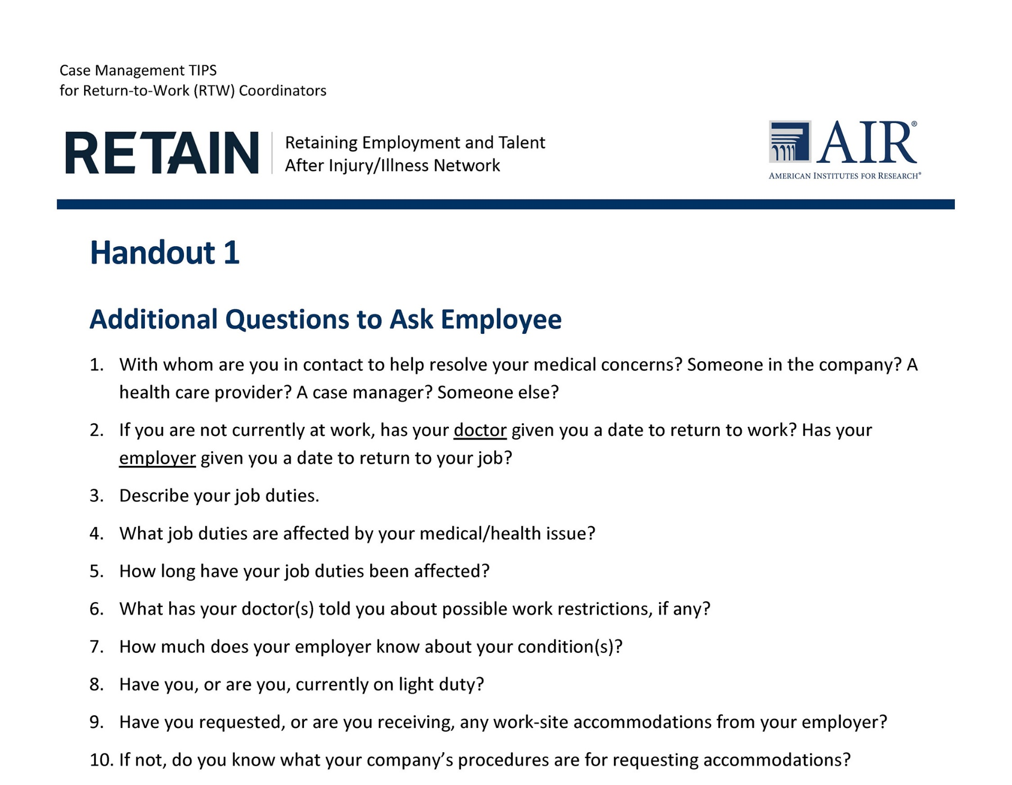
Handout 1: Additional
Questions to Ask Employee

Slide 14
Questions to Ask Employer
Employee awareness of the employer’s opinion
Employer awareness of the employee’s situation
Attitudinal barriers present

Slide 15
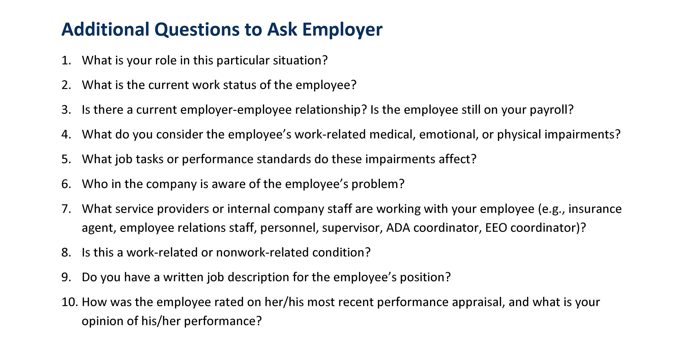
Handout 1: Additional
Questions to Ask Employer

Slide 16
Indicators of
Problems on the Job
Determine the likelihood of success of RTW/SAW
Additional services needed by the employee
Additional services needed by the employer

Slide 17
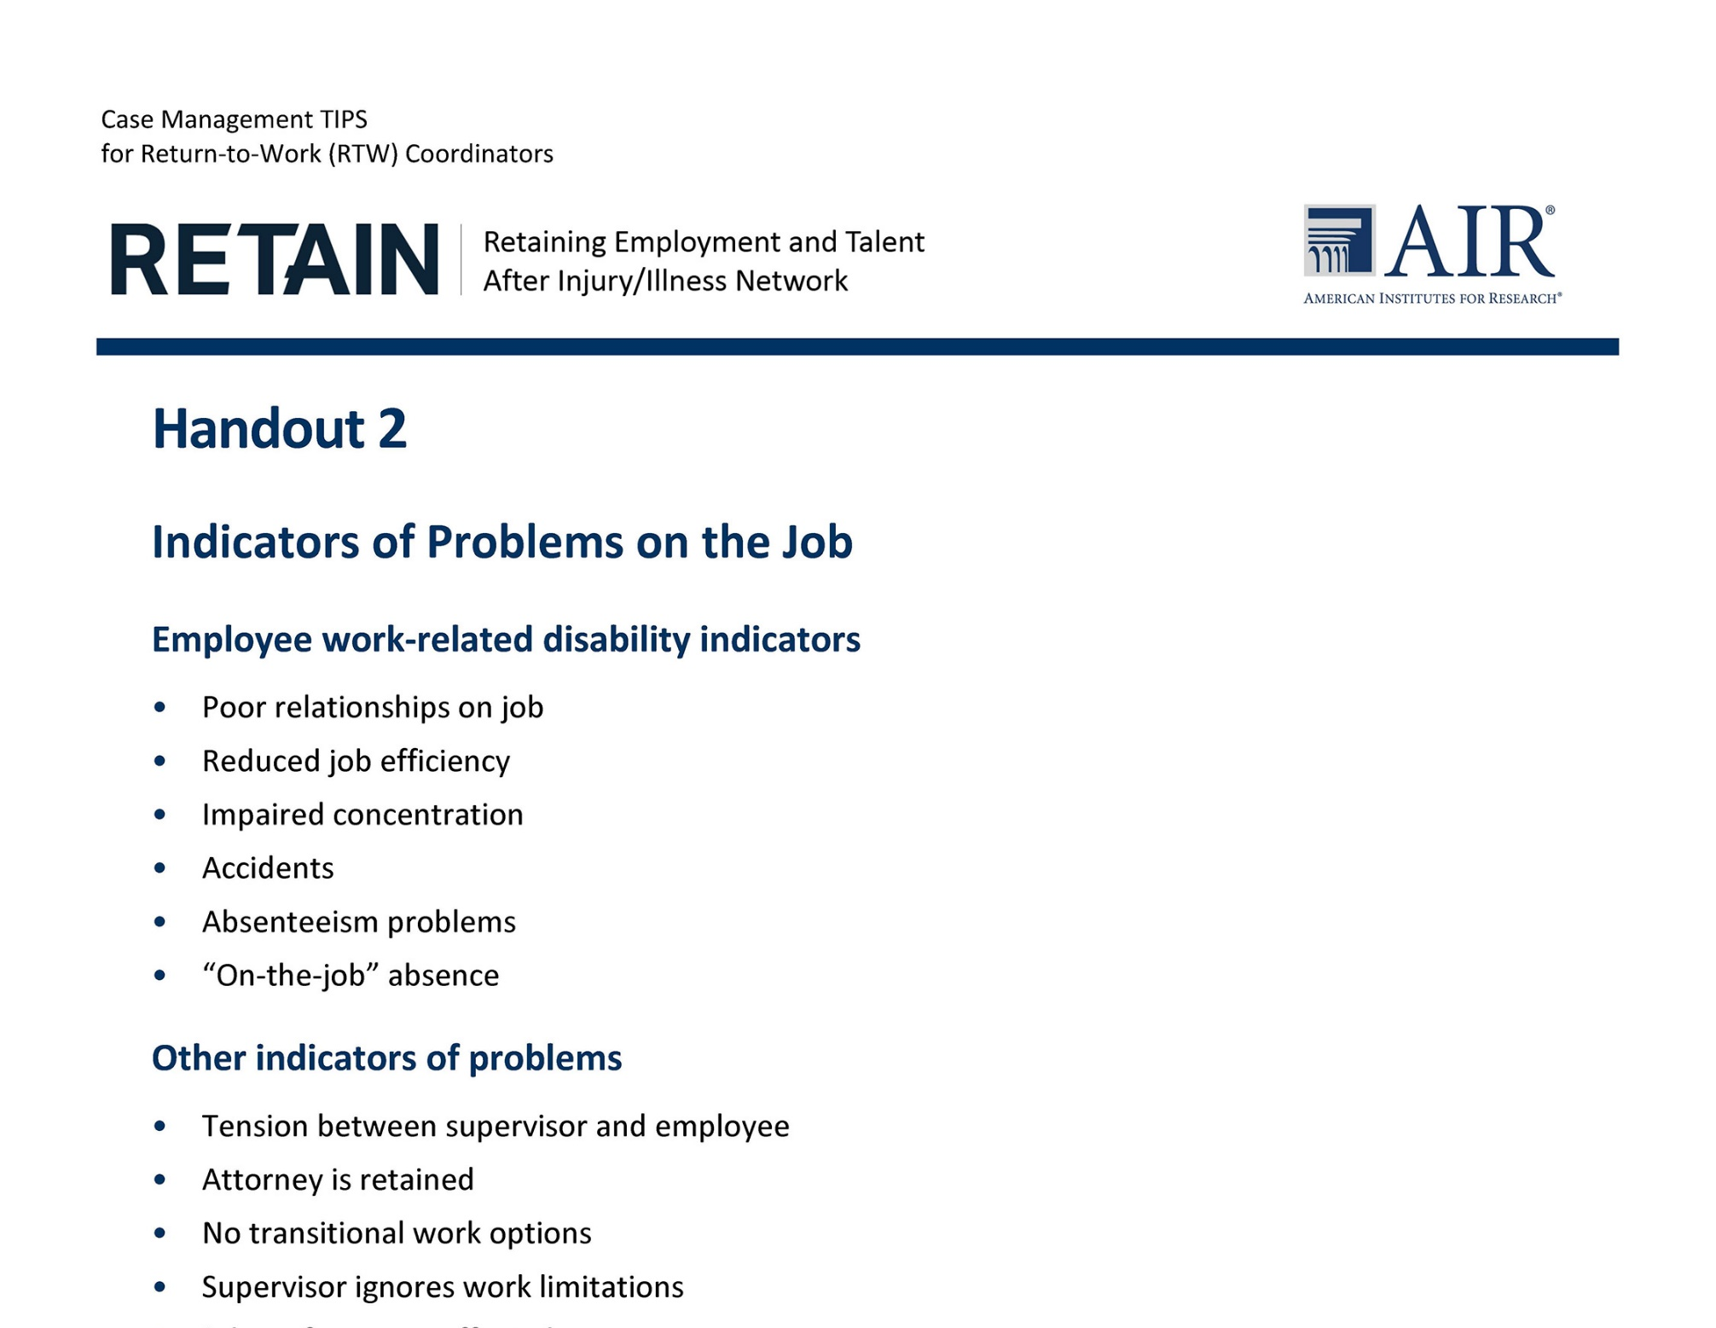
Handout 2: Indicators of Problems on the Job

Slide 18
Helpful Documents
Job description
Leave records
Most recent performance appraisals
Disciplinary or corrective action plan, if applicable
Work history and reasons for leaving previous positions

Slide 19

Insights
Touch Points
Photo from Unsplash.com
Notes:
Question: What do you, as a RTW Coordinator, consider to be a light touch, medium touch, and a more complex Touch Point.
I light touch can still be complex. The complexity of a RTW case will depend on the answer to a lot of the questions provided in the Tools section.
Of the questions for the employee – which questions may lead to a more complex case?
Of the questions for the employer – which questions may lead to a more complex case?

Slide 20
Insights
Revisiting
“Jack the Plumber”

Slide 21
Case Study 1: Jack
Jack is a 45-year-old man with lower lumbar pain.
He is a high school graduate.
He began working at Slaton’s Mechanical
24 years ago.
He has journeyman’s license in plumbing.
Jake fell off a ladder
6 months ago at home.
Jack sustained a lower back injury.
He has herniated discs pressing against his sciatic nerve.
Jack would like to return to work.
He has been referred to your state’s RETAIN program.
Notes:
Jack is a 45-year-old man with lower lumbar pain. Jack graduated high school and began working with Slaton’s Mechanical company when he was 21 years old through an apprenticeship. He has no additional college training. As a result of completing his apprenticeship, Jack earned a journeyman’s license in plumbing and has worked for Slaton’s Mechanical for the past 20 plus years. About 6 months ago, Jack fell off a ladder at his house and injured his lower back. At the time of the injury he was told he had some herniated discs that were pressing against his sciatica nerve, as well as nerves leading to his legs. Jack would like to return to work and has been referred to your state’s RETAIN program.
What steps would the RTW take to assist Jake in being able to continue to work?
What are the Touch Points in the current scenario?
Once Jake’s disability progresses in severity, what are the new Touch Points and how comfortable are you, as the RTW coordinator, in the complexity of the case?

Slide 22
Case Study 1: Jack
Jack opted to access short-term disability.
Six months later, he returned to work.
The pain continued, and he went off work again.
Jack went back on short-term disability and had another surgery.
His pain worsened along with tingling and pain in his lower back and legs.
Jack wants to return to work, and his employer wants to bring him back to work.
Both are concerned about his safety and safety of others.
Jack and his employer are concerned about his ability to do the required job tasks.
Jack and employer are seeking RTW assistance.
Notes:
Jack’s company offered Short Term Disability and Long Term disability as an employee benefit. Jack decided he needed to access the Short Term Disability assistance while he continued to receive medical treatment. After 6 months, Jack tried to return to work for a few months, but the pain continued. He went off work again, went back on STD and had another surgery. Thus far the surgery has not been helpful.
Jack really enjoys his job and enjoys working for his employer. However, Jack’s back pain continues to worsen. At this time, Jack is having issues with tingling and shooting pain in his lower back and legs. Although he is still limited in what he can do, Jack wants to return to work and Slaton’s Mechanical wants to bring him back to work. There are concerns by both Jack and Slaton’s Mechanical around his personal safety, safety to others and his ability to do the required job tasks. Jack and Slaton’s Mechanical is seeking assistance in Returning to Work.

Slide 23
Processes
RTW Plans
RTW Service Delivery
Roles and Responsibilities

Slide 24
Processes
RTW Plans
Required Data Elements
Purpose?
Tell the story?
Are services clear?

Slide 25
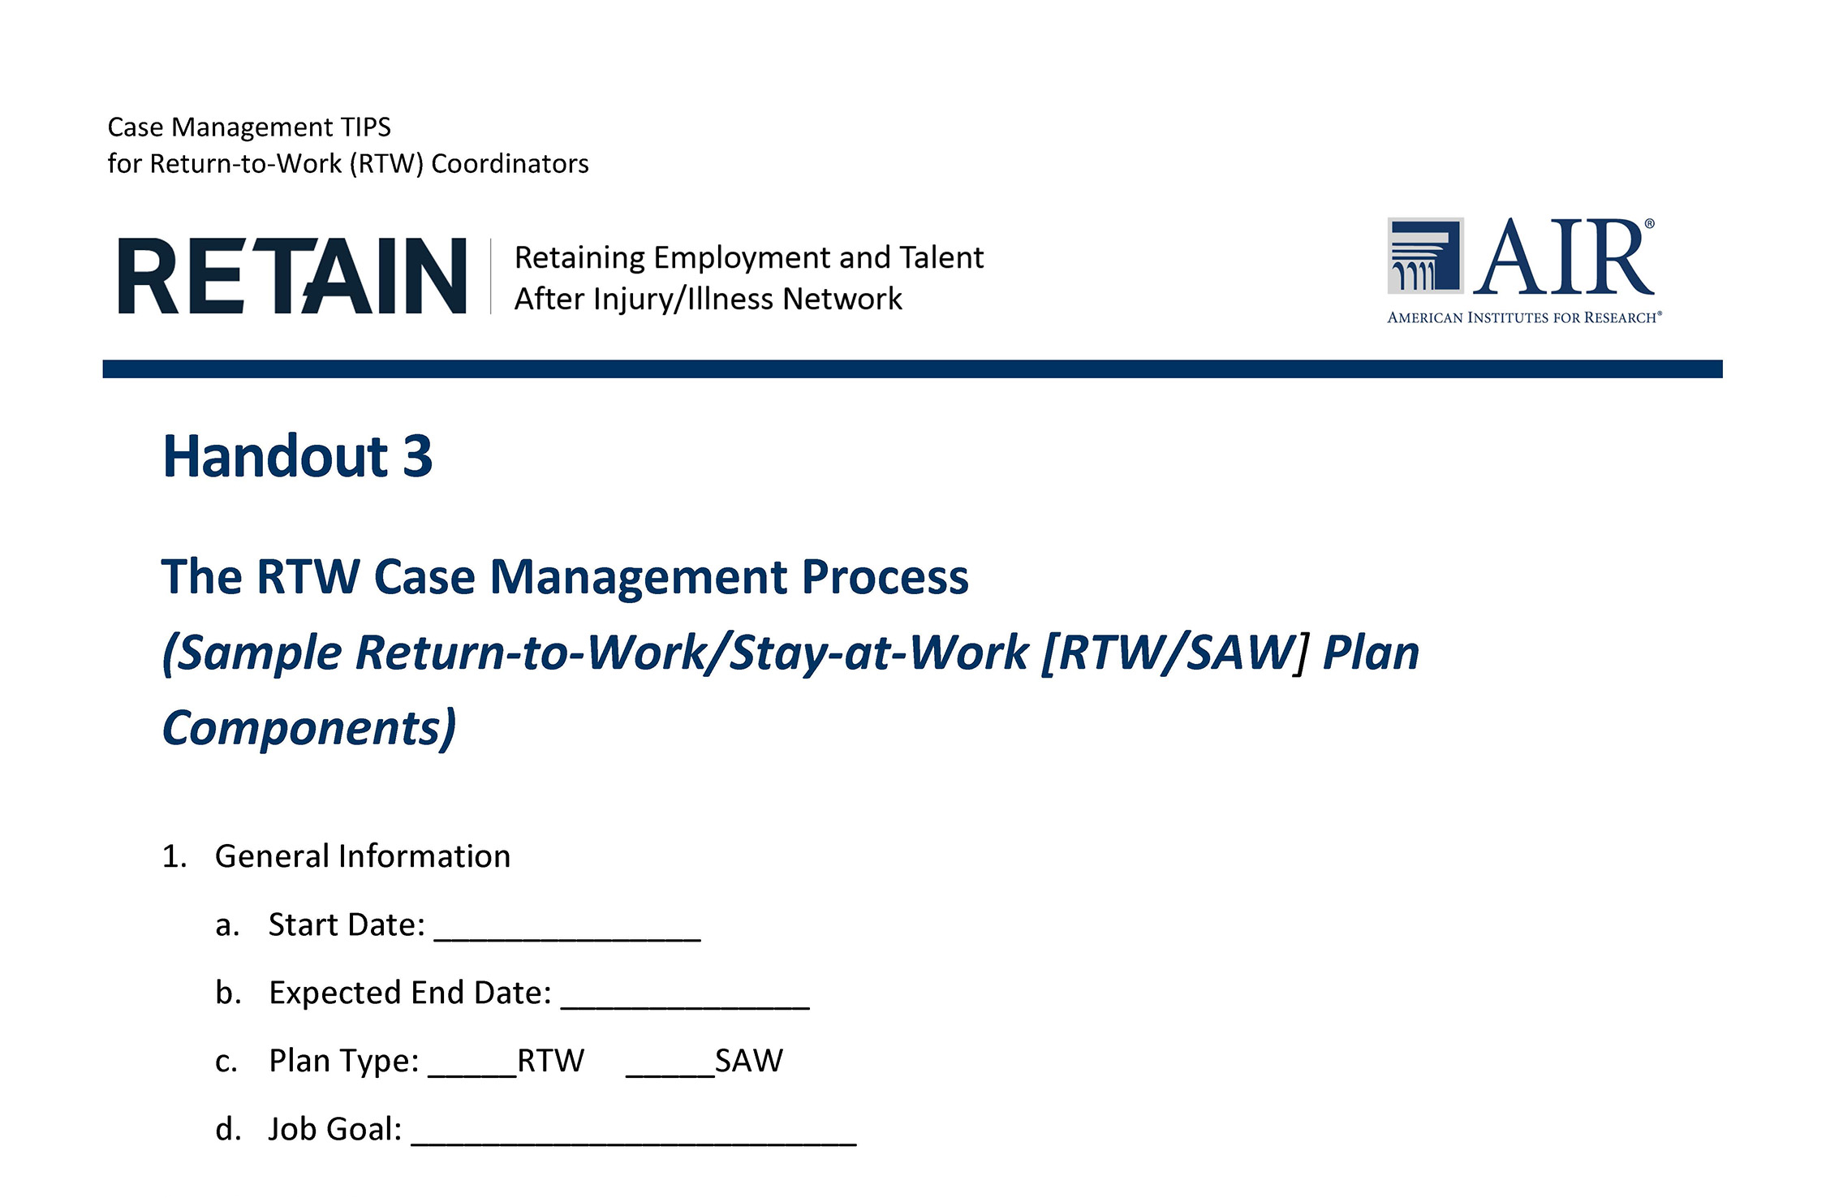
RTW Case Plan Sample

Slide 26
Processes
RTW Service Delivery
Assessment
Counseling and guidance
Assistive technology/accommodation evaluation
Accommodations
Medical or psychological intervention
Retraining
Job coaching
Resource linkages
Assistance with reassignment
Outplacement assistance
Employer Services
Employer intervention and education
Task analysis
Technical assistance
Resource linkages
Accommodation identification
Financial incentives
Ongoing follow-up
Outplacement: Employees
Personal use items
Employer coordination

Slide 27
Roles and Responsibilities
Employee
Health Care Provider
Employer
RTW Coordinator
Notes:
Handout 6

Slide 28
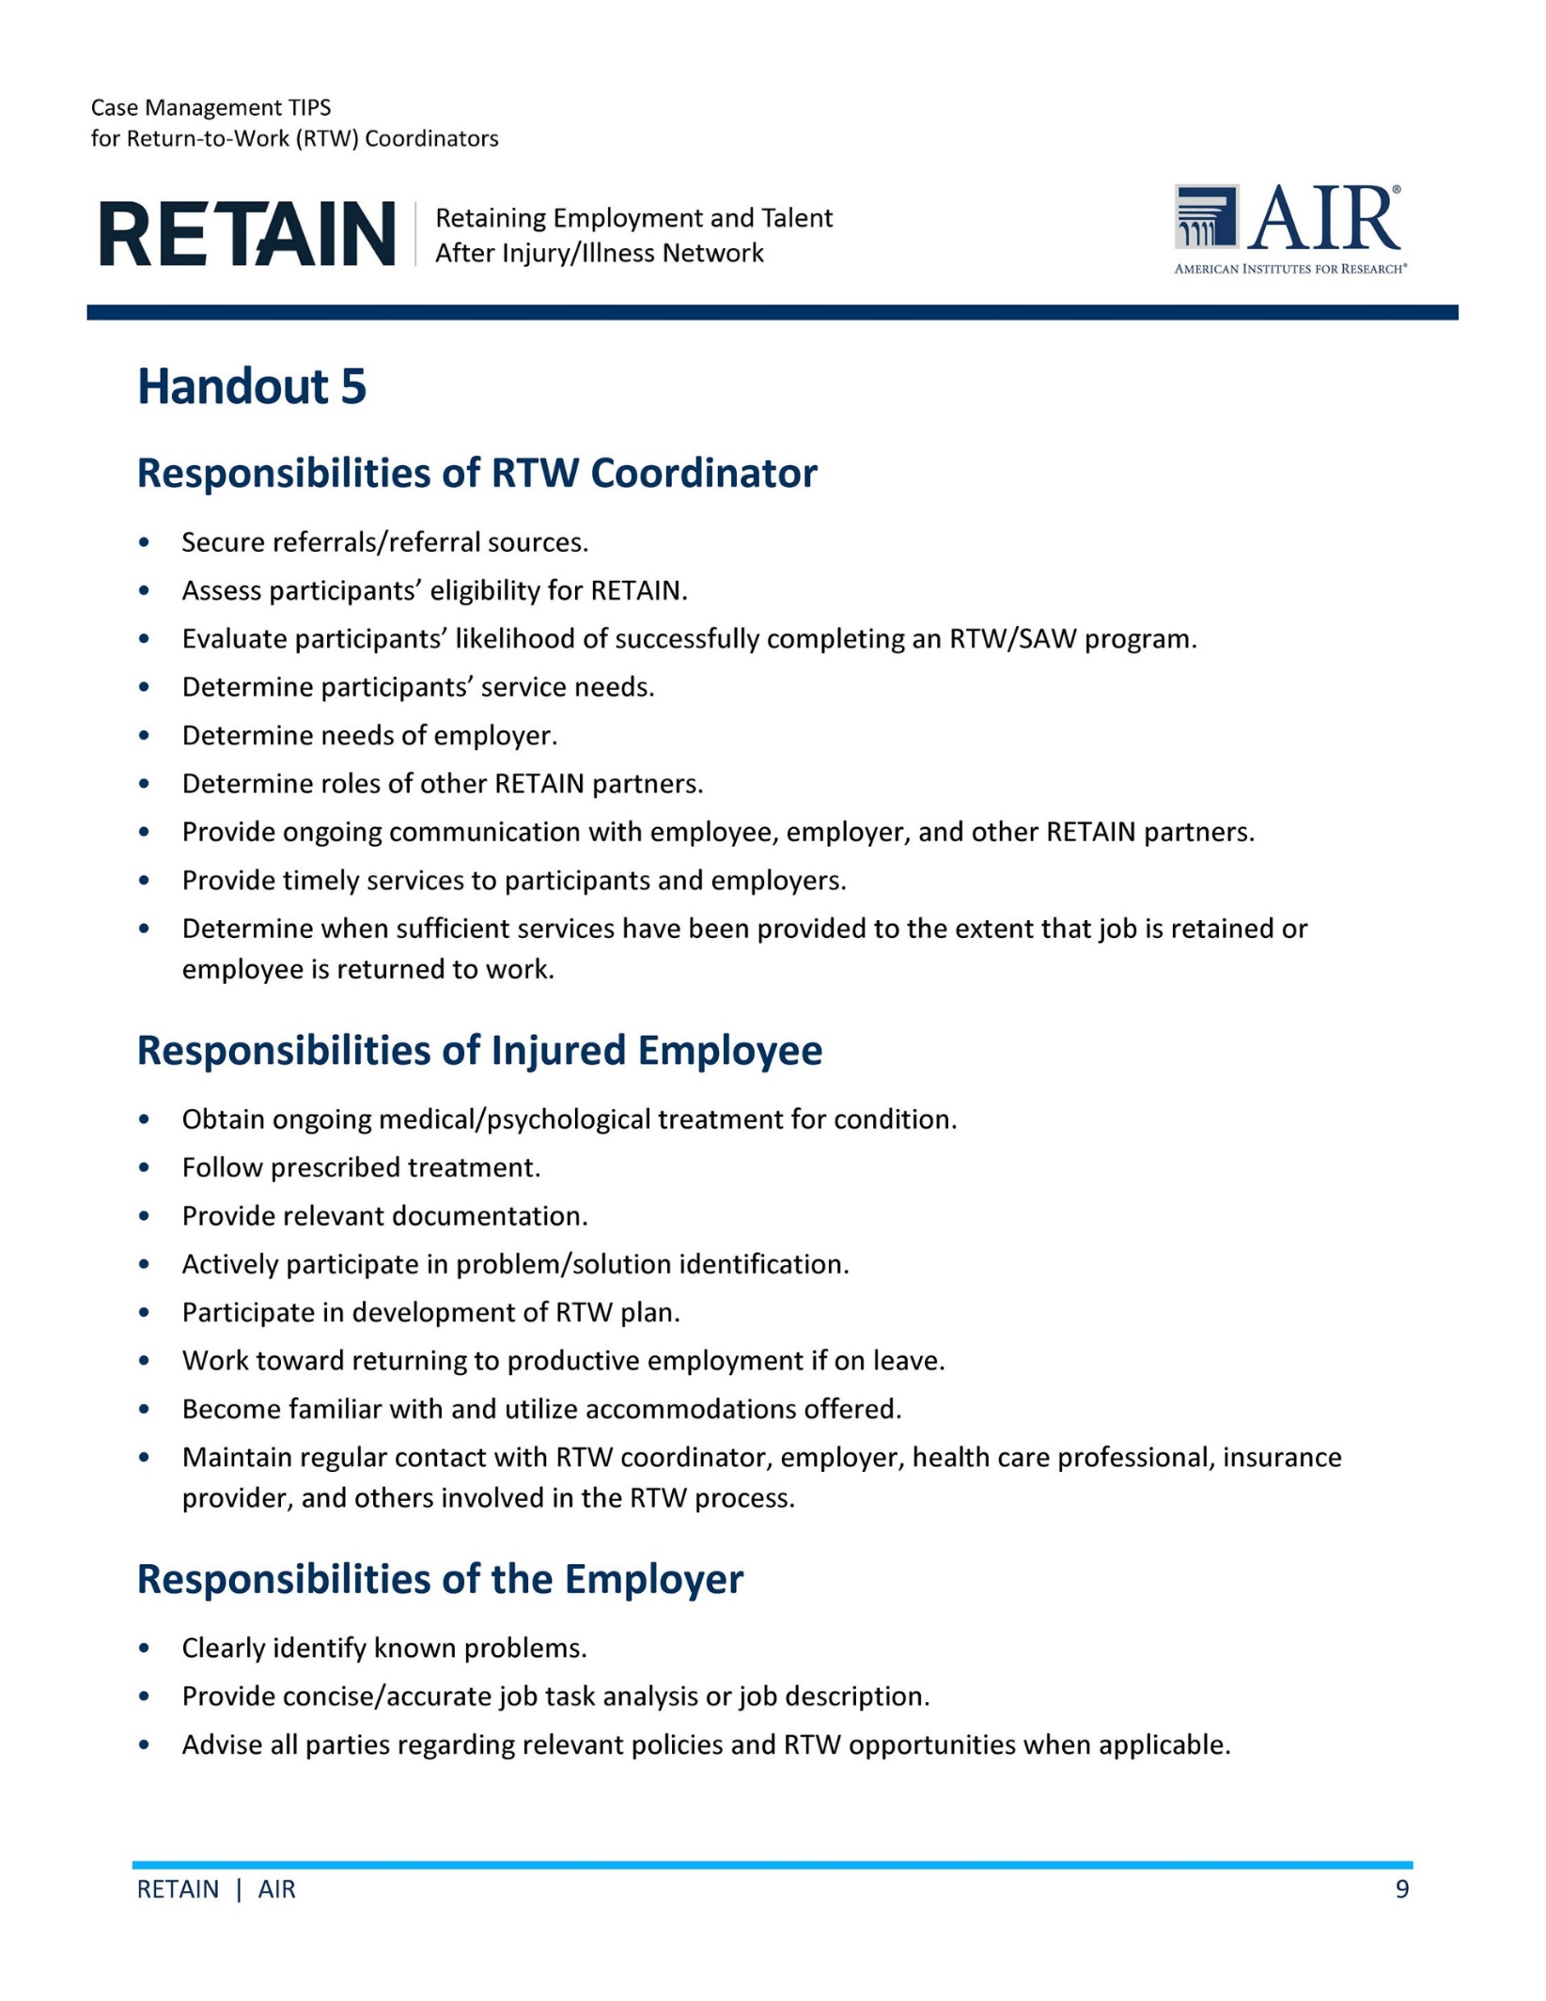
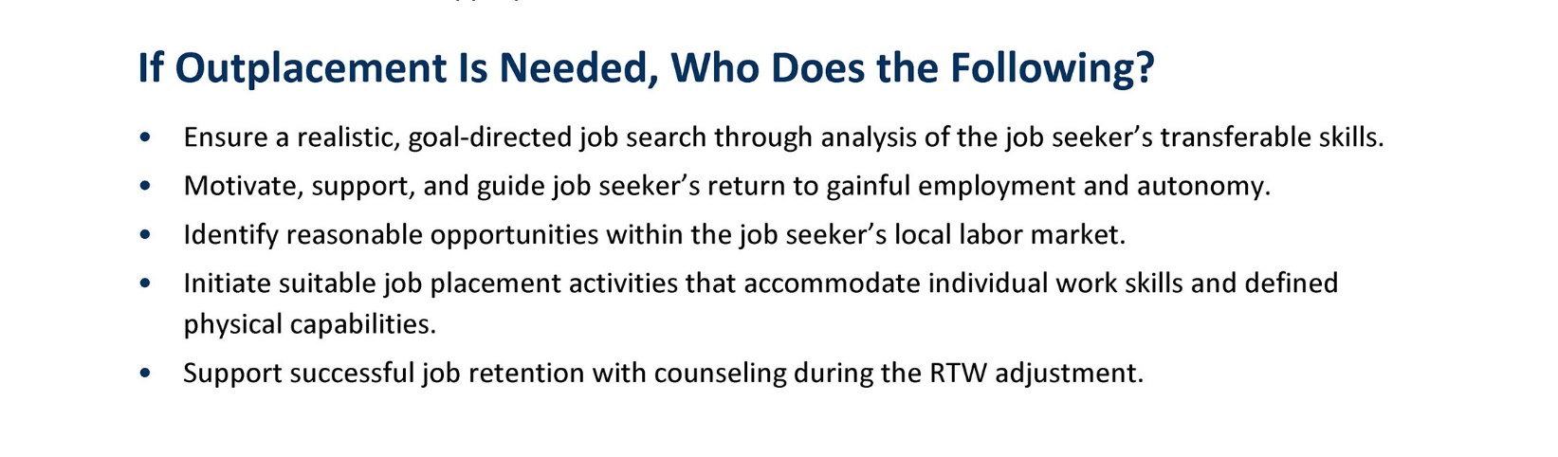
Roles and Responsibilities

Slide 29
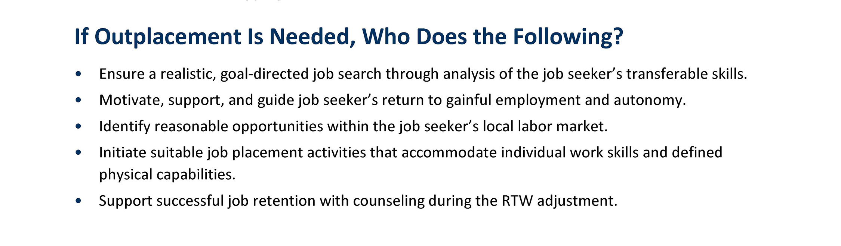
Roles and Responsibilities

Slide 30
Processes
Case Study 2: Lumber Mill and Carpal Tunnel Syndrome

Slide 31
Case Study 2: Tina
Tina, a 32-year-old woman, works at a lumber mill and is complaining of carpal tunnel pain in her right wrist.
She was referred to RETAIN by her employer.
Tina works on the quality control line. Her job is to stand on the side of a conveyor belt and look for boards with imperfections.
Based on the imperfection, Tina will mark a “grade” on the board.
She visited the occupational health nurse who prescribed anti-inflammatory medication, but it has not helped.
The employer noted an increase in complaints of carpal tunnel issues at the lumber mill.

Slide 32
Strategies
Approaching employers
Light duty vs. transitional employment
Accommodations vs. modifications

Slide 33

Key Takeaways
Share a key takeaway from today’s discussion.
What are the next steps you will take?
Any remaining questions or needs that you would like follow-up on?

Slide 34
Save the Date!
Community of Practice (CoP) Series: “Focus on Job Retention Best Practices”
CoP 2: How the ADA and Reasonable Accommodations Can Make or Break a RETAIN Case
April 23, 2020, 2:00–3:00 p.m. ET
Appropriate implementation of Americans with Disabilities Act (ADA) requirements and the provision of reasonable workplace accommodations is a significant part of a successful SAW/RTW model. This live CoP will equip RTW coordinators and other RETAIN team members with an understanding of the ADA essential functions and reasonable accommodations.
Registration details are coming soon!

Slide 35
Thank you for your participation today!
Please complete the end-of-session survey! https://www.surveymonkey.com/r/
04_02_2020CoP_RTW-TIPS
CoP slides and notes will be accessible on the
RETAINTA Online Community (ROC): https://retainta.org

