Slide 1
Health Equity Tips for Developing Inclusive Communication in RETAIN Programs

Slide 2
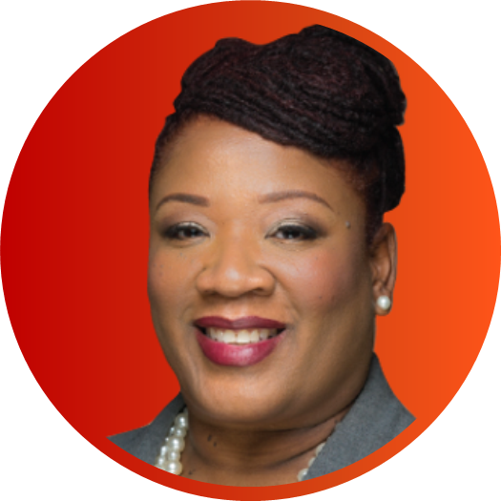
Today’s Presenters
RHONDA WALLER, PhD
Managing Director, Health Solutions Practice Area of Excellence,
THE BIZZELL GROUP
As a psychologist with more than 20 years of professional experience, Dr. Waller specializes in maternal and child health, education, and human services, with an emphasis on cultural competency, program development, leadership development, capacity building, and training and technical assistance. Dr. Waller is highly skilled in program design and implementation, coalition building, and the development of community-based strategies to enhance diversity, equity, and inclusion efforts; improve access to health care; adapt the delivery of educational services; and enable supports for all. She has led numerous training and technical assistance initiatives for federal, private-sector, and nonprofit organizations across the country.

Slide 3
Today’s Presenters (cont.)
NANCY BATEMAN, MSW
Senior Public Health Analyst & Technical Writer, THE BIZZELL GROUP
Ms. Bateman has decades of experience in developing culturally competent written communications utilizing person-first and inclusive language and writing for diverse audiences for the U.S. Department of Health and Human Services (HHS), including the National Institutes of Health, the Centers for Disease Control and Prevention (CDC), the Food and Drug Administration, and the Substance Abuse and Mental Health Services Administration; and the U.S. Department of Defense and U.S. Department of Labor. She has 30+ years of experience as a policy analyst, program manager, technical writer, and clinically trained social worker, including 10 years as an Employee Assistance Program manager working with diverse populations. She is proudest of her work in the behavioral health field, which has given her an understanding of the specific cultural, language, social, and economic nuances of people and organizations.

Slide 4
Agenda
What Is Inclusive Communication?
The Power of Words, Language, and Images
Inclusive Versus Non-Inclusive Language
Health Equity Lens in Communication
Principles for Inclusive Communication
Inclusive Communication Strategies for Diverse Stakeholders
Resources
Notes:
Rhonda/Script: To build a healthy workforce, it is imperative that RETAIN programs address inequities that might exist within local communities. Today's webinar highlights ways RETAIN teams can achieve this through inclusive communication that reflects the diverse needs of the people they serve.
We will highlight tips and best practices to help RETAIN teams (you) ensure their (your) communication products are developed through a health equity lens. Our topics will include the importance of person-first language, preferred terms for select populations, and resources for developing inclusive communication products.

Slide 5
Ice Breaker
How would you describe yourself?
Add two or three personal identifiers to the Word Cloud.
On a separate sheet of paper, add any other identifiers. We will come back to those later.
This Photo by Unknown author is licensed under CC BY-SA-NC.
Notes:
Rhonda/Script: Take a moment to think about your personal identity. Using the word cloud \ link in the chat, submit two or three words you use to identify yourself in everyday settings—just the first two or three things that come to mind. After you do this, feel free to write down other identifiers on a sheet of paper that would further describe who you are.
We want you to feel safe to say what comes to mind. These will not be revealed to others.
We want you to feel safe. … Inclusivity is making people feel welcome. Even asking this question might make people feel vulnerable.
This is uppercase in the PP file. It only needs to be capitalized if it’s a proper noun. I won’t mark it again.

Slide 6
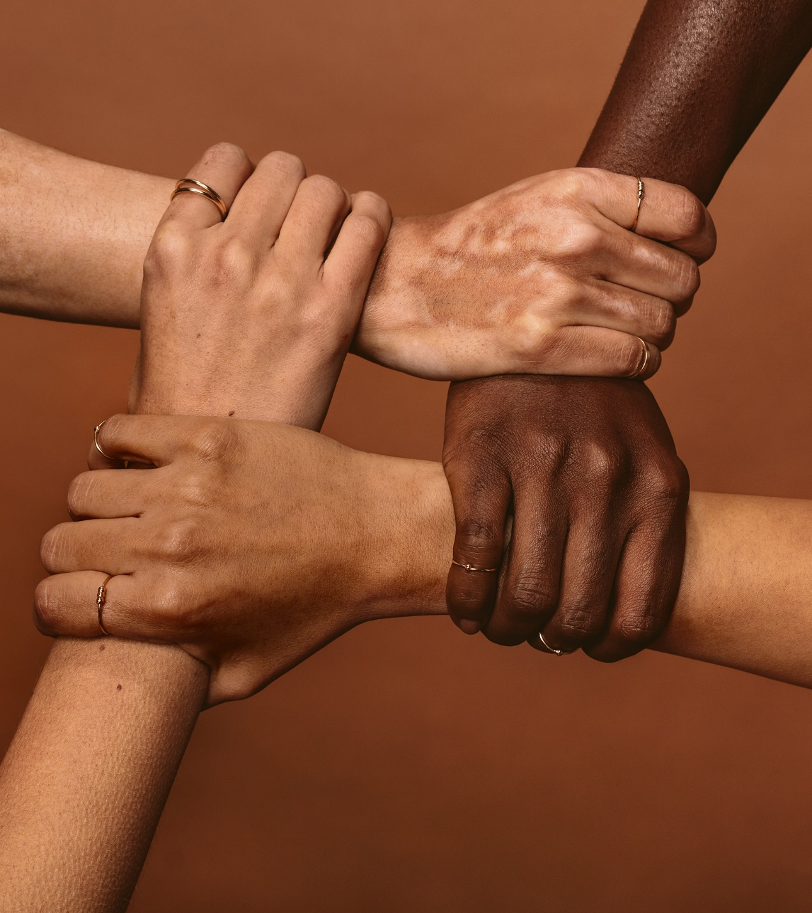
What Is Inclusive Communication?
Inclusive communication acknowledges diversity, conveys respect to all people, is sensitive to differences, and promotes equitable opportunities.
This refers to the language and images used in emails, marketing materials, social media posts, websites, and other forms of communication.
Notes:
Rhonda/Script: By being inclusive, we create “an environment that offers affirmation, celebration, and appreciation of different approaches, styles, perspectives, and experiences, thus allowing all individuals to bring in their whole selves (and all their identities) and to demonstrate their strengths and capabilities.“
Inclusive communication acknowledges diversity, conveys respect, is sensitive to differences, and promotes equitable opportunities.
The use of inclusive language and images in emails, marketing material, social media, websites, and other forms of communication relays the message that your programs and services are accessible and welcoming to everyone. Inclusive language allows you to resonate with more audiences by speaking and writing in more impartial ways.
*******************
Sources:
APA’s Equity, Diversity and Inclusion Framework:
APA. (2021b). Equity, diversity, and inclusion framework. https://www.apa. org/about/apa/equity-diversity-inclusion/equity-division-inclusion-framework.pdf
Definition of inclusion: “an environment that offers affirmation, celebration, and appreciation of different approaches, styles, perspectives, and experiences, thus allowing all individuals to bring in their whole selves (and all their identities) and to demonstrate their strengths and capacity.”
18F Content Guide:
U.S. General Services Administration (GSA). 18F content guide. https://content-guide.18f.gov/our-style/
“As we build government services, we want to ensure they are accessible and welcoming to everyone who needs to use them. Inclusive language helps us to be more accurate and build trust with our users.”

Slide 7
The Power of Words, Language, and Images
The words we use are key to creating psychologically safe, inclusive, respectful, and welcoming environments.
Language is a tool that can draw us closer together (positive connection) or drive us further apart (create distance).
Representation matters. Intersectionality and images can shape the perception of your audience. Visuals have the pressure of the first impression and carry the value of lasting impressions.
Notes:
Rhonda: Script: The words we use are key to creating psychologically safe, inclusive, respectful, and welcoming environments.
Language is a tool that can draw us closer together (positive connection) or divide us further apart (create distance).
Representation matters. Intersectionality and images can shape the perception of your audience. Visuals have the pressure of the first impression and carry the value of lasting impressions.
************************************
Sources:
18F Content Guide (Note: This is a federal government project, so it’s in the public domain.)
U.S. General Services Administration (GSA). 18F content guide. https://content-guide.18f.gov/our-style/
Inclusive language: “The words we use can make the difference between forging positive connections or creating distance in our personal and professional lives. Particularly in writing, impact is more important than intent.”
APA’s Inclusive Language Guidelines:
APA. (2021). Inclusive language guidelines. https://www.apa.org/about/apa/equity-diversity-inclusion/language-guidelines
Language is a powerful tool that can draw us closer together or drive us further apart. “Simply put, words matter. The words we use are key to creating psychologically safe, inclusive, respectful, and welcoming environments.”

Slide 8
Inclusive Communication: Language Choices
Who is the audience?
What is the tone/level of formality?
What are the goals?
How might history change the impact of my language choices regardless of my intentions?
Who is being excluded?
Make conscious, intentional language choices.
Inclusive language allows you to resonate with more audiences by speaking and writing in more impartial ways.
Sources: Conscious Style Guide; 18F Content Guide ​
Notes:
Rhonda/Script: “Conscious or inclusive language asks us to think critically about using language to empower instead of limit. … language that is rooted in critical thinking and compassion. Some words are more apt than others. The most important part of conscious language is the conscious part—our intention.”
As we walk through this presentation, we will explore questions you should consider as you develop communications products and messages—questions that move you to empower your audience; that help you reflect on the goal and intention of your communication; that help you evaluate whether the words, language, and images are inclusive, compassionate, and intentional. Inclusive language avoids biases, slang, or expressions that discriminate against groups of people based on race, gender, or socioeconomic status. Inclusive language allows you to resonate with more audiences by speaking and writing in more impartial ways.
Nancy/Script: Here are five specific questions. As you think about your audience, there are several layers to consider. Who is your audience in relationship to RETAIN? Are they a program participant, partner, or a team member? Also consider identity, such as the following:
Who is the audience?
Ability and disability
Age
Gender and sexuality
Nationality
Race, ethnicity, and religion
What is the tone/level of formality?
Consider literacy levels as well as primary spoken/read languages.
What are the goals?
How might history change the impact of my language choices regardless of my intentions? (LGBT 10 years ago; more inclusive as LGBTQIA; has progressed over time)
Who is being excluded?
A few overriding points:
Regarding race, gender, or disability, it’s always best to ask people how they identify rather than assuming.
Avoid terms that contribute to stigmas regarding disability.
Use gender identity/sexual orientation descriptors as modifiers, not nouns (“transgender person,” “lesbian woman”). Use “different sex” versus “opposite sex.”
It’s okay to use “they”/”their” as singular pronouns.
***************************************************
Source:
Conscious Style Guide:
Quiet Press. (2015–2022). Conscious style guide. https://consciousstyleguide.com/
Does it make sense to say “gender, … or other genders”?
Is this correct as a source?

Slide 9
Non-Inclusive Language
Language that treats people unfairly, insults, or excludes a person or group of persons.
Impact on individuals/community
Exclusion
Isolation
Lack of support
Feelings of discrimination
My best
friend
is Black.
You speak such good English.
I love your people!
You’re not like the others.
It was just a joke.
Notes:
Rhonda/Script:
What is the impact of non-inclusive language to the community? Examples: feelings of discrimination, exclusion, isolation, sense of danger, lack of support.

Slide 10
Images
Include people of diverse genders, people with visible disabilities, and people from all racial/ethnic groups. Avoid stereotypes and ensure equity with status.
Consider the need for alternative text.
On webpages, ensure that the main guidance is not in graphics that screen readers would not understand.
Avoid:
Using traditional/cultural dress images
Showing inequity in status with images
Perpetuating unhealthy body images
Illustrating racial or ethnic minority group caricatures
Use cultural artifacts, products, or other features only when they have appropriate meaning to the communications (e.g., colors have specific, sometimes different meanings in various cultures).
Notes:
Rhonda/Script: Images also have the power to connect. They can create an environment that is inclusive or exclusive for your audience. Your audience’s response to images/visual components can affect whether they engage with your messages or perceive they are valued. For instance, some RETAIN programs are creating materials that are being tailored toward specific communities. As you develop the visual components of your communications, consider these points to ensure you’re creating an environment that is inclusive and engaging and shows your audience they are valued. This can be particularly important in RETAIN’s efforts to recruit participants for the program. You want to ensure that the images, as well as the words, resonate with your audience—that you select images that represent potential participants, ones they can identify with. Also know that some states are developing materials that are tailored toward specific communities. It can be helpful to solicit input from advisory boards or community partners on these types of products to see if they think they will resonate.
Source:
CDC. Gateway to Health Communication. Health equity guiding principles for inclusive communication. https://www.cdc.gov/healthcommunication/Health_Equity.html

Slide 11
CDC’s Health Equity Guiding Principles for Inclusive Communication
Notes:
Nancy/Script: The CDC has developed a set of guiding principles that emphasize the importance of addressing all people inclusively, accurately, and respectfully. It provides current best practices, suggestions, and resources that can help you develop inclusive communications. CDC developed these with public health professionals in mind—particularly health communicators—so they would have tools to ensure their communication products and strategies adapt to the specific needs and priorities of each population or audience. It’s a living document that will change as language and norms change. And it’s also a useful resource for RETAIN staff as you develop various external materials for your partners, participants, the public, and other stakeholders—as well as internal communications for your teams. These principles can guide not just the words and images in your communication products but also how you engage with your communities, partners, stakeholders, and team.
Source:
CDC. Gateway to Health Communication. Health equity guiding principles for inclusive communication. https://www.cdc.gov/healthcommunication/Health_Equity.html

Slide 12
Health Equity
Health equity refers to dismantling disparities and creating lasting solutions so that everyone has a fair and just opportunity to achieve their full health potential. This requires removing obstacles to health, such as poverty, discrimination, and their consequences.
When using a health equity lens in communications, you must intentionally look at the potential impacts (positive and negative) of proposed messages.
Be inclusive.
Avoid bias and stigmatization.
Reach the audience effectively.
Solicit input from the intended audience.
Sources: CDC, U.S. Department of HHS. (2021, December 7). CDC’s health equity guiding principles for inclusive communication fact sheet; Braveman, P., Arkin, E., Orleans, T., Proctor, D., & Plough, A. (2017, April). What is health equity? And what difference does a definition make? Health Equity Issue Brief #1. Robert Wood Johnson Foundation.
Notes:
Nancy/Script: CDC framed these principles using a health equity lens. In the slide, I have a more formal definition, and I know that this is not a new concept for all of you, but health equity means eliminating health disparities so that everyone has the opportunity to be as healthy as possible. And to do this, you have to address economic and social obstacles to health, such as poverty and discrimination as well as powerlessness and lack of access to good jobs with fair pay, quality education and housing, safe environments, and health care. When you talk about using a health equity lens in your communications, that means you have to look at any positive or negative impacts from a proposed message—think back to some of the points Dr. Waller made about inclusive and non-inclusive language and images—and being intentional and conscious in your choices.
The goals are to
be inclusive,
avoid bias and stigmatization,
reach the audience effectively, and
ideally solicit input from the intended audience.
Source:
Braveman, P., Arkin, E., Orleans, T., Proctor, D., & Plough, A. (2017, April). What is health equity? And what difference does a definition make? Health Equity Issue Brief #1. Robert Wood Johnson Foundation.
Also had shorter definitions:
[20-second definition for general audiences]: “Health equity is the ethical and human rights principle that motivates us to eliminate health disparities; health disparities—worse health in excluded or marginalized groups—are how we measure progress toward health equity.”
[8-second definition for general audiences]: “Health equity means removing economic and social obstacles to health such as poverty and discrimination.”

Slide 13
Health Equity Considerations
Notes:
Script: So, let’s identify a few things to consider.
First, you want to avoid perpetuating any inequities in your programs/services and your communications. For example, when you’re connecting with a potential community partner or stakeholder group, you don’t want to use language that implies an individual or community is responsible for any increased adverse outcome or risk—such as vague terms like “vulnerable” or “high-risk” populations. Another term that comes to mind that was often used in program reports is referring to an individual as “non-compliant” or “compliant”—again, implying individual responsibility versus acknowledging societal, environmental, or other factors outside their control, that are obstacles to programs, services, and so forth.
Second, to be successful, you need to develop programs and services that reflect your community’s or state’s diversity. I know that several RETAIN states have specifically assessed how and where they recruit participants and deliver services so that they can ensure the program’s success. In doing so, you also need to look at messages that will reach and engage that community.
One way to do that is to engage them in developing communication (and programs and services). This can include engaging stakeholders in co-creating and curating content as well as examining your internal operations and ensuring that you are open to discussing the development of policies and practices that are inclusive to your external audiences.
Health equity as intersectional calls us to recognize that health is shaped by overlapping factors, such as age, ability, race, income, education, immigration status, and geography. How are you, as a program, addressing this and communicating it to your various stakeholders?
The last consideration relates to literacy—both reading and comprehension. Literacy levels may vary significantly among your different audiences. Let’s take a look at literacy levels in the United States. A quick poll … next slide ...
***********************************************************************************************
Source:
CDC. Gateway to Health Communication. Using a health equity lens. https://www.cdc.gov/healthcommunication/Health_Equity_Lens.html

Slide 14
Participant Poll
What is the average reading grade level for Americans?
Notes:
Poll Question: What is the average reading grade level for Americans?
Answer: The average reading grade level for Americans is 7th to 8th grade. However, half of U.S. adults can NOT read at the 8th-grade level. About 20% of the population are categorized as having a low level of English literacy.
When developing language-based materials, you need to consider your audience and use a reading level that is accessible to your audience of focus. That reading level may vary depending on your audience and the purpose of your materials. For example, the words you choose and the complexity of sentences may differ if your audience consists of state policymakers, versus health care providers, versus potential participants.
Sources:
[Average American reads at the 7th- to 8th-grade level]: Marchand, L. (2017, March 22). What is readability and why should content editors care about it? Center for Plain Language. https://centerforplainlanguage.org/what-is-readability/
[Half of U.S. adults can’t read a book written at the 8th-grade level, according to the OECD]: Strauss, V. (2016, November 1). Hiding in plain sight: The adult literacy crisis. Washington Post.
[About 21% of American adults are categorized as having a low-level English literacy.]: IES, NCES. (2019, July). Adult literacy in the United States. Retrieved October 16, 2021, from https://nces.ed.gov/pubsearch/pubsinfo.asp?pubid=2019179

Slide 15
Participant Poll (cont.)
How many languages are spoken in the United States?
Notes:
Poll Question: How many languages are spoken in the United States?
Answer: More than 350. In 2017, the U.S. Census Bureau published this information based on the American Community Survey (2009–2013). That is a lot of languages. And according to the 2020 U.S. Census Bureau, 22% of the U.S. population speak a language other than English at home, and 78% only speak English. Another thing to consider when developing language-based materials is whether there are other predominant languages in your state that will help you reach potential participants and ensure that you are representing the diversity of workers in your state.
Based on annual data from the American Community Survey, the U.S. Census Bureau regularly publishes information on the most common languages spoken at home. It also reports the English-speaking ability of people who speak a language other than English at home.
Source:
American Community Survey. Language spoken at home by ability to speak English for the population 5 years and over (Table B16001) 2013–2017 5-year estimates. Archived from the original on February 14, 2020. Retrieved December 13, 2018.
In 2017, the U.S. Census Bureau published information on the number of speakers of more than 350 languages as surveyed by the ACS from 2009 to 2013, but it does not regularly tabulate and report data for that many languages. Sources: U.S. Census Bureau. (2015, November 3). Census Bureau reports at least 350 languages spoken in U.S. homes. Retrieved July 3, 2018, from https://www.census.gov/newsroom/archives/2015-pr/cb15-185.html Castillo, J. (2015, November 4). At least 350 languages spoken in US homes: New report. CNBC. Retrieved July 3, 2018, from https://www.cnbc.com/2015/11/04/at-least-350-languages-spoken-in-us-homes-new-report.html

Slide 16
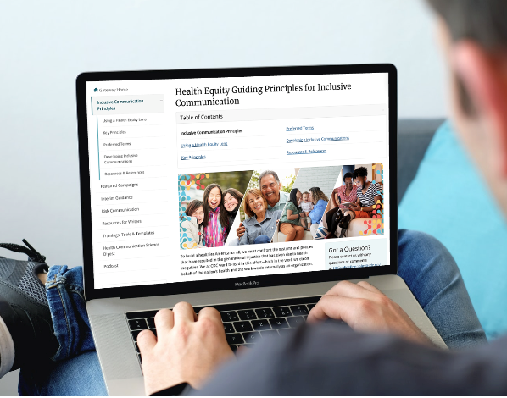
Key Principles for Inclusive Communication
Notes:
Rhonda/Script: The CDC’s guidelines present five principles to consider for all written and oral communications. These are best practices that you should consider when communicating with any of RETAIN’s audiences, whether it’s a health care provider who’s assisting you with recruitment and enrollment, outreach materials for a potential partner, an employer, an internal email to the team, or a potential participant. We’re going to walk through each principle and highlight alternative terms that are more inclusive.

Slide 17
Key Principle
Avoid use of adjectives such as “vulnerable,” “marginalized,” and “high-risk.”
Notes:
Nancy/Script: Choose terms that focus on systems and why/how some groups or communities that you are trying to reach are more affected and explain the effect (e.g., groups that have been marginalized, under-resourced communities, disproportionately affected groups, groups with higher risk of …).

Slide 18
Key Principle (cont.)
Key principle | Instead of this … | Try this …
Avoid use of adjectives such as “vulnerable,” “marginalized,” and “high-risk.” | Vulnerable groups Marginalized communities Hard-to-reach communities Underserved communities Underprivileged communities Disadvantaged groups High-risk groups At-risk groups High-burden groups | Groups that have been economically/socially marginalized Groups that have been historically marginalized or made vulnerable; historically marginalized Groups that are struggling against economic marginalization Communities that are underserved by/with limited access to (specific service/resource) People in under-resourced communities Groups experiencing disadvantage because of (reason) Groups placed at increased risk/put at increased risk of (outcome) Groups with higher risk of (outcome) For scientific publications: Disproportionately affected groups Groups experiencing disproportionate prevalence/rates of (condition)
Notes:
Nancy/Script: These terms can be stigmatizing. They are vague and imply that the condition is inherent to the group rather than the actual causal factors. Try to use terms and language that explain why and/or how some groups are more affected than others. Also try to use language that explains the effect (i.e., words such as “impact” and “burden” are also vague and should be explained). “Underserved” is related to having limited access to accessible, acceptable, and affordable services, including health care. If using that term, you need to be specific and clear—what don’t these communities have access to? Transportation, health care, and so forth? Do not use “underserved” when you mean disproportionately affected.
Imagine receiving a document or brochure that identifies you as being in a vulnerable group, or in a high-risk group. Is that welcoming to you?
Sources:
Adapted from: CDC. Gateway to Health Communication. Health equity guiding principles for inclusive communication. https://www.cdc.gov/healthcommunication/Health_Equity.html
Note: The chart was included in: American Medical Association and Association of American Medical Colleges. (2021). Advancing health equity: A guide to language, narrative and concepts. https://www.ama-assn.org/equity-guide

Slide 19
Key Principle (cont. 2)
Avoid dehumanizing language. Use person-first language instead.
Notes:
Nancy/Script: Person-first language puts the person before their disability, diagnosis, or other identity group, condition, or trait. Person-first language describes what a person has rather than who a person is. It avoids labeling people, which can be dehumanizing and promote stereotypes, stigma, and biases. Source:
Institute on Disability, University of New Hampshire. (2022). Person-first language: A partial glossary of disability terms. https://iod.unh.edu/person-first-language-partial-glossary-disability-terms “We know that language shapes perceptions, so a small word choice can make a big difference in communicating attitudes towards people with disabilities and assumptions about the quality of their lives.
Person-first language literally puts the person first instead of his or her disability. By referring to an individual as a person with a disability instead of a disabled person, you are providing an objective description instead of a label. While opinions differ on some words, this list offers preferred terms for many visible and invisible disabilities, illustrated with person-first language.”
Sources: APA Inclusive Language Guidelines (this expands on above):
Person-first language was initially applied to issues related to people with disabilities but has since been broadened to include other identity groups, including identities related to age. APA also notes that the individual’s preferences for language would supersede style guidelines. Person-first emphasizes the person, not their disability/condition. Identity-first focuses on the condition or disability. There may be instances when the individual prefers, for various reasons, to use identity-first language.
APA. (2021). Inclusive language guidelines. https://www.apa.org/about/apa/equity-diversity-inclusion/language-guidelines
Crocker, A. F., & Smith, S. N. (2019). Person-first language: Are we practicing what we preach? Journal of Multidisciplinary Healthcare, 12, 125–129. https://doi.org/10.2147/JMDH.S140067

Slide 20
Key Principle (cont. 3)
Take note:
Individual preference supersedes this guideline.
Some may prefer identity-first language.
Deaf community: Deafness = medical condition (not a disability).
Notes:
Nancy/Script: However, APA has emphasized that the individual’s preferences for language would supersede guidelines on person-first. There may be instances when an individual prefers to use identity-first language. For example, one group that has chosen to embrace identity-first versus person-first language is the deaf community. The deaf community views deafness as a medical condition, not a disability, and as such should not carry a negative connotation.
Source: APA Inclusive Language Guidelines
APA. (2021). Inclusive language guidelines. https://www.apa.org/about/apa/equity-diversity-inclusion/language-guidelines

Slide 21
Key Principle (cont. 4)
Key principles | Instead of this … | Try this …
Avoid dehumanizing language. Use person-first language instead. | The obese or the morbidly obese Coronavirus disease 2019 (COVID-19) cases The homeless, homeless person Disabled person Handicapped Inmates Victims Cases or subjects (when referring to affected persons) Individuals Mentally ill Elderly, the aged, seniors, senior citizens | People experiencing (health outcome or life circumstance) People with obesity; people with severe obesity Patients or persons with COVID-19 People who are experiencing (condition or disability type) Person with mobility disability Person with vision impairments People who are experiencing homelessness Survivors Person living with a mental health condition/mental disorder/mental illness Older adults, older people, persons 65 years and older, the older populations
Notes:
Nancy/Script: However, APA has emphasized that the individual’s preferences for language would supersede guidelines on person-first. There may be instances when an individual prefers to use identity-first language. For example, one group that has chosen to embrace identity-first versus person-first language is the deaf community. The deaf community views deafness as a medical condition, not a disability, and as such should not carry a negative connotation.
Source: APA Inclusive Language Guidelines
APA. (2021). Inclusive language guidelines. https://www.apa.org/about/apa/equity-diversity-inclusion/language-guidelines

Slide 22
Key Principle (cont. 5)
Be as specific as possible about the group you are referring to and remember that there are many types of subpopulations.
Notes:
Nancy/Script: Read the principle.

Slide 23
Key Principle (cont. 6)
Key principle | Instead of this … | Try this …
Be as specific as possible about the group you are referring to and remember that there are many types of subpopulations. | Minorities Minority Ethnic groups Racial groups | Specify the type of subpopulation: (People from) racial and ethnic groups (People from) racial and ethnic minority groups (People from) sexual/gender/ linguistic/religious minority groups (People with/living with) limited mobility (People with/living with) cognitive/vision/hearing disabilities
Notes:
Nancy/Script: Use of the term “minority”/”minorities” should be limited, in general, and should be defined when used. Be as specific as possible about the group you are referring to. For example, instead of saying “minorities,” specify who you are referring to. So, people who are Asian American, Pacific Islander, …
Source:
Adapted from: CDC. Gateway to Health Communication. Health equity guiding principles for inclusive communication. https://www.cdc.gov/healthcommunication/Health_Equity.html
Note: The chart was included in: American Medical Association and Association of American Medical Colleges. (2021). Advancing health equity: A guide to language, narrative and concepts. ama-assn.org/equity-guide.

Slide 24
Key Principle (cont. 7)
Avoid saying “target,” “tackle,” “combat,” or other terms with violent connotations when referring to people, groups, or communities.
Notes:
Nancy/Script: Indicate the principle.

Slide 25
Key Principle (cont. 8)
Key principle | Instead of this … | Try this …
Avoid saying “target,” “tackle,” “combat,” or other terms with violent connotations when referring to people, groups, or communities. | Target communities for interventions Target population Tackle issues within the community Aimed at communities Combat (disease) War against (disease) | Engage/prioritize/collaborate with/serve (population of focus) Consider the needs of/tailor to the needs of (population of focus) Communities/populations of focus Intended audience Eliminate (issue/disease)
Notes:
These terms should also be avoided, in general, when communicating about public health activities.
Using words that are strongly associated with violence and power connotations can make people feel attacked, unsafe, or not empowered.
Source:
Adapted from: CDC. Gateway to Health Communication. Health equity guiding principles for inclusive communication. https://www.cdc.gov/healthcommunication/Health_Equity.html
Note: The chart was included in: American Medical Association and Association of American Medical Colleges. (2021). Advancing health equity: A guide to language, narrative and concepts. ama-assn.org/equity-guide.

Slide 26
Key Principle (cont. 9)
Avoid unintentional blaming.
Notes:
Nancy/Script: State the principle.

Slide 27
Key Principle (cont. 10)
Key principle | Instead of this … | Try this …
Avoid unintentional blaming. | Workers who do not use personal protective equipment (PPE) People who do not seek health care People who refuse to seek mental health treatment, medical treatment, or supportive services | People with limited access to (specific service/resource) Workers under-resourced with (specific service/resource) People who have yet to receive (treatment, services)
Notes:
Nancy/Script: Consider the context and the audience to determine if language used could potentially lead to negative assumptions, stereotyping, stigmatization, or blame. However, these terms may be appropriate in some instances. Do not assume that people are refusing or choosing not to participate in a behavior or to access a service. Structural issues, access issues, or acceptability may play a role. For instance, a lack of accessible transportation can have an impact on someone’s ability to access services or resources.
Source: Adapted from: CDC. Gateway to Health Communication. Health equity guiding principles for inclusive communication. https://www.cdc.gov/healthcommunication/Health_Equity.html
Note: The chart was included in: American Medical Association and Association of American Medical Colleges. (2021.) Advancing health equity: A guide to language, narrative and concepts. ama-assn.org/equity-guide.

Slide 28
Community Engagement
Hire people from the community served, including those disproportionately affected.
Involve the community in the development process when feasible.
Work with community partners on priorities and strategies.
Work with community-serving organizations to incorporate needs, priorities, and opportunities into the design of public health interventions tailored for their specific communities.
Adjust recommendations that do not make sense for specific situations, communities, or cultures.
Notes:
Nancy/Script: Another strategy for ensuring your communications are inclusive and appeal to diverse stakeholders is to find ways to engage the communities that RETAIN (you) serves. There are several ways you can do this, such as including them in the development process, hiring people from the communities served, and working with your community partners on the program’s priorities and strategies. I’ve talked to several states that are doing several of these. Think about whether there are additional partners in the community who can help you meet these goals of engagement.
Ask: Can you indicate any community-engaged strategies you’ve used that have helped you build inclusivity into your communications?
Ask states to note any strategies that they have found particularly successful for building inclusivity in their communications.
Source: CDC Inclusive Communication Guidelines:
CDC. Gateway to Health Communication. Health equity considerations for developing public health communications. https://www.cdc.gov/healthcommunication/Comm_Dev.html

Slide 29
Accessibility of Communication
Make information available in accessible formats (e.g., large print, braille, American Sign Language, closed captioning, audio, video, plain language, visual/graphic imagery) for people with vision, hearing, cognitive, and learning disabilities.
Use straightforward, easy-to-understand language.
Ensure that information is culturally responsive, accessible, and available.
Notes:
Rhonda/Script: Information should be made available in accessible formats (e.g., large print, braille, American Sign Language, closed captioning, audio descriptions, plain language) for people with vision, hearing, cognitive, and learning disabilities.
Ensure equal access to public health services for people with disabilities and operation of disability services before, during, and after public health emergencies.
Ensure that information is culturally responsive, accessible, and available. It should represent the people in the communities for whom it is intended.

Slide 30
Audience
Tailor communications for the audience.
Consider their:
Identity
Ability and disability
Age
Gender and sexuality
Nationality
Race, ethnicity, and religion
Literacy levels
Primary spoken language
Input when feasible
Notes:
Nancy/Script: These next few slides provide a summary or checklist of the key points to consider as you develop communication products. These slides will be distributed, but we are also going to create a separate resource that includes these key points and the resources on the final slide. These will be distributed through the ROC. Hopefully, this will be useful to you.

Slide 31
Images
When selecting images:
Represent diverse genders, races, ethnic groups, and people with visible disabilities.
Avoid always using traditional/cultural dress images, depicting inequity in status, and perpetuating unhealthy body images or racial and ethnic minority group caricatures.
Use cultural artifacts only when they have appropriate meaning to the communications.

Slide 32
Inclusive Language/Formats
Avoid using adjectives such as “vulnerable,” “marginalized,” and “high-risk.” Choose terms that focus on systems and how/why some groups are more affected.
Use person-first language. Avoid dehumanizing language.
Be as specific as possible when referring to groups and remember that there are many types of subpopulations.
Avoid terms with violent connotations (“tackle,” “combat”) when referring to people, groups, and communities.
Avoid terms that may be unintentionally blaming.
Use straightforward, easy-to-understand language.
Consider appropriate formats for your audience: audio, video, braille, large print, visual/graphic imagery, American Sign Language, closed captioning, plain language.

Slide 33
Ice Breaker Follow-Up
How would you describe yourself?
Add your personal identifiers to the Word Cloud.
This Photo by Unknown author is licensed under CC BY-SA-NC.
Notes:
Rhonda/Script: Let’s take a moment to rethink your personal identifiers. Using the word cloud link in the chat, submit as many words as you would use to identify yourself in everyday settings.
Now let’s look at this “new” word cloud alongside the first word cloud. Is it more inclusive?

Slide 34
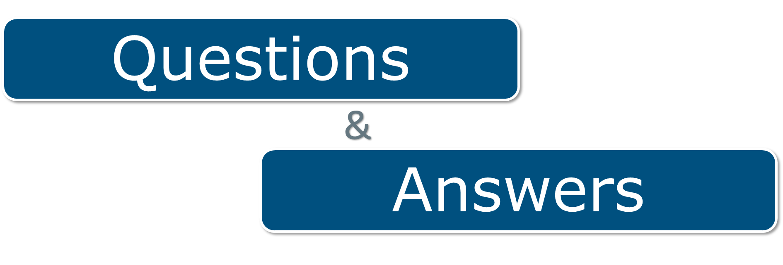
Questions & Answers

Slide 35
Resources and References
American Medical Association and Association of American Medical Colleges. (2021). Advancing health equity: A guide to language, narrative and concepts. https://www.ama-assn.org/equity-guide
American Psychological Association (APA) Style. (2019). General principles for reducing bias. https://apastyle.apa.org/style-grammar-guidelines/bias-free-language/general-principles
APA. (2021). Inclusive language guidelines. https://www.apa.org/about/apa/equity-diversity-inclusion/language-guidelines.pdf
APA. (2021b). Equity, diversity, and inclusion framework. https://www.apa. org/about/apa/equity-diversity-inclusion/equity-division-inclusion-framework.pdf
CDC. Gateway to Health Communication. Health equity guiding principles for inclusive communication. https://www.cdc.gov/healthcommunication/Health_Equity.html
CDC Gateway to Health Communication, https://www.cdc.gov/healthcommunication/index.html, provides links to the Health Equity Guiding Principles, featured CDC partner campaigns, example training, tools and templates, and a resource section for writers.
Institute on Disabilities, University of New Hampshire. Person-first language: A partial glossary of disability terms. Retrieved February 2022 from https://iod.unh.edu/person-first-language-partial-glossary-disability-terms
Plain Language.gov includes guidelines, examples, resources, and trainings on incorporating plain language into communications.
Quiet Press. (2015–2022). Conscious style guide. https://consciousstyleguide.com/about/
Section508.gov provides resources on website accessibility, including creating accessible meetings and digital products.
U.S. General Services Administration (GSA). 18F content guide. https://content-guide.18f.gov/our-style/

